Slide 1

Data Science with Python
Presented by
Shivam Patel
11611415

Slide 2
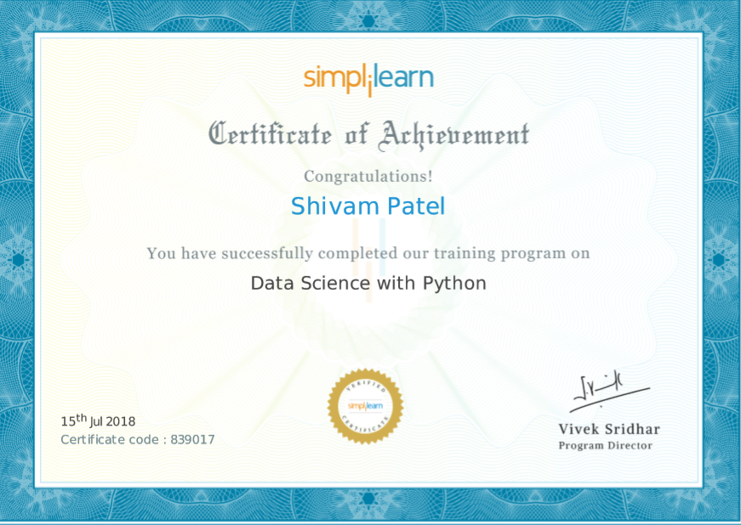
Certificate: Data Science with Python

Slide 3
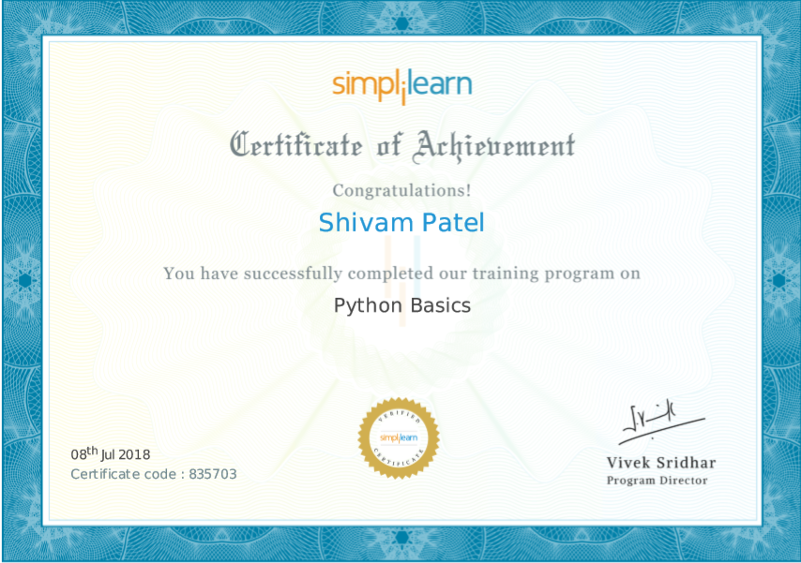
Certificate: Python Basics

Slide 4

What is Data Science?
Data science is an interdisciplinary field that uses scientific methods, processes, algorithms and systems to extract knowledge and insights from data in various forms, both structured and unstructured.

Slide 5

Why is Data Science important?
Data science helps brands to understand their customers in a much enhanced and empowered manner.
Big Data is a new field that is constantly growing and evolving. With so many tools big data is helping brands and organisations to solve complex problems in IT and other fields.
Data Science allows brands to communicate their story in such a engaging and powerful manner. When brands and companies utilize this data in a comprehensive manner, they can share their story with their target audience, thereby creating better brand connect.

Slide 6
Data Science with Python
Why Python?
Python is one among the most popular dynamic programming languages that is being used today.
Python is an open-source and object-oriented programming language developed by Dutchman Guido van Rossum in 1980s.
Code can be grouped into modules and packages.
This language can be utilized for a wide range of applications like scripting, developing and testing. Due to its elegance and simplicity, top technology organizations like Dropbox, Google, Quora, Mozilla, Hewlett-Packard, Qualcomm, IBM, and Cisco have implemented Python.

Slide 7
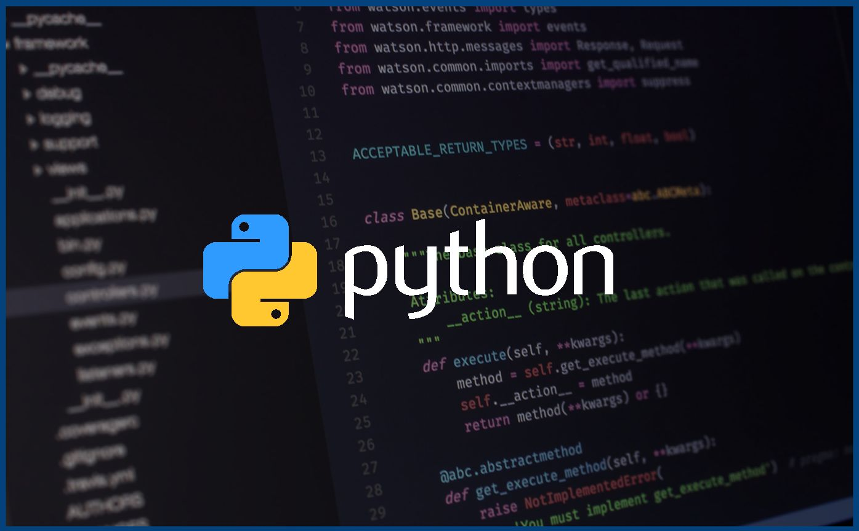
Python Programming Overview
Downloading and installing python
Data Types (int, sets, list,tuples, booleans, etc) and Operators ( Arithmetic, logical, comparison, etc)
Control statements (if- else, if- elif, if-elif –else,if)
Loops (for and while)
Functions ( def keyword is used to create function)

Slide 8
Python Programming Overview
Tuples- A tuple is a sequence of immutable Python object. Ex- tup1=(‘physics’,’maths’,1,2), tup2=(‘Bio’,’English’,3,4)
Built in Tuple function:cmp(tup1,tup2), len(tup1), max(tup1), min(tup1).
Lists- Lists are one of the most powerful tools in Python. They are just like the arrays declared in other languages.EX= list1=[1,2,3,4,5]
Built functions of List are list.append(obj), list.count(obj), list.index(index,obj), list.remove(obj),etc.

Slide 9
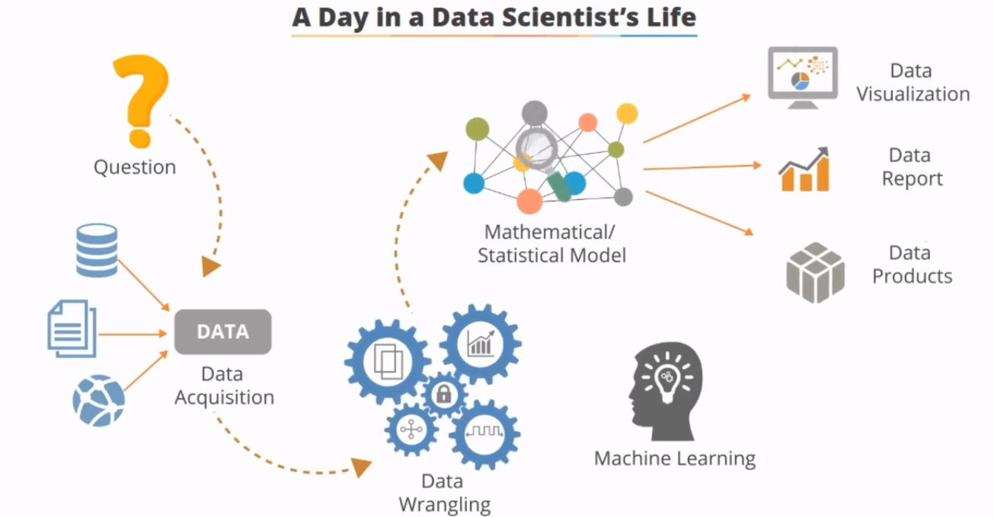
A Day in a Data Scientist’s Life

Slide 10
Libraries used in Data Science
Numpy library: NumPy stands for Numerical Python. The most powerful feature of NumPy is n-dimensional array. This library also contains basic linear algebra functions, Fourier transforms, advanced random number capabilities and tools for integration with other low level languages like Fortran, C and C++.
syntax to import Numpy: import numpy as np
Nd –array: a = np.array([1,2,3])
Various in built functions in Numpy library are:
numpy.linspace- Ex:- x=np.linspace(10,20,5)
numpy.arange – Ex:- x = np.arange(5)

Slide 11
Libraries used in Data Science
Scipy Library:- SciPy stands for Scientific Python. SciPy is built on NumPy. It is one of the most useful library for variety of high level science and engineering modules like discrete Fourier transform, Linear Algebra, Optimization and Sparse matrices.
Scipy- Linalg: It is used to solve linear algebra problems. It contains functions like solve, det, svd, eig(for eigen values)
A = np.array([[1,2],[3,4]])
b = np.array([2, 4, -1])
det- to calculate determinant of a matrix. Syntax: x = linalg.det(A)
Eig- To calculate Eigenvalues and Eigenvectors of matrix. Syntax: l, v = linalg.eig(A)
Solve- To solve the value of x,y,z in linear equations x = linalg.solve(aA b)

Slide 12
Libraries used in Data Science
Pandas Library:- In computer programming, pandas is software library written for the Python programming language for data manipulation and analysis.
DataFrame object for data manipulation with integrated indexing.
import pandas as pd
data1={'London':{2012:205}, 'Beijing':{2008:201}}
pd.DataFrame(data1)
2) Tools for reading and writing data between in-memory data structures and different file formats using read and write function.
3) Data alignment and integrated handling of missing data.
4) Data structure column insertion and deletion.

Slide 13
Libraries used in Data Science
Matplotlib Library Matplotlib is a Python 2D plotting library which produces publication quality figures in a variety of hardcopy formats and interactive environments across platforms.
Syntax to import the library: from matplotlib import pyplot as plt
There are various type of plots which can be generated by the use of this library. Ex: Bar chart, Pie chart, histogram, plot and etc.
Lets check out the project for more use of these libraries.

Slide 14
Project
NYC 311 Service Request Analysis
Perform a service request data analysis of New York City 311 calls. You will focus on the data wrangling techniques to understand the pattern in the data and also visualize the major complaint types.
Import a 311 NYC service request
Basic data exploratory analysis
Explore data
Find patterns
Display the complaint type and city together
Find major complaint types
Find the top 10 complaint types
Plot a bar graph of count vs. complaint types
Visualize the complaint types
Display the major complaint types and their count

Slide 15
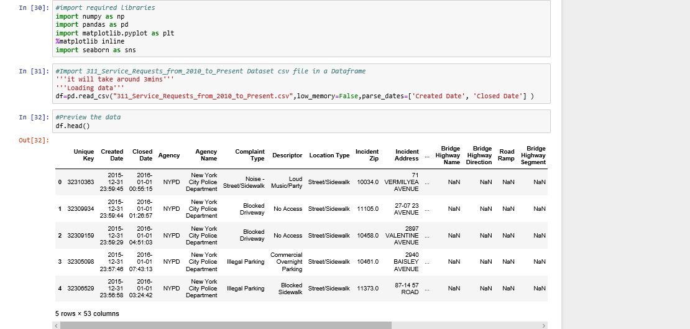

Slide 16
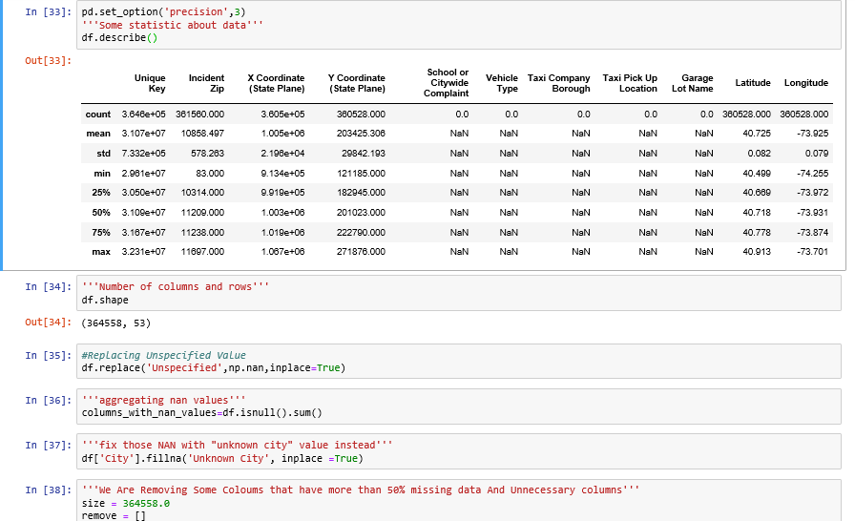

Slide 17
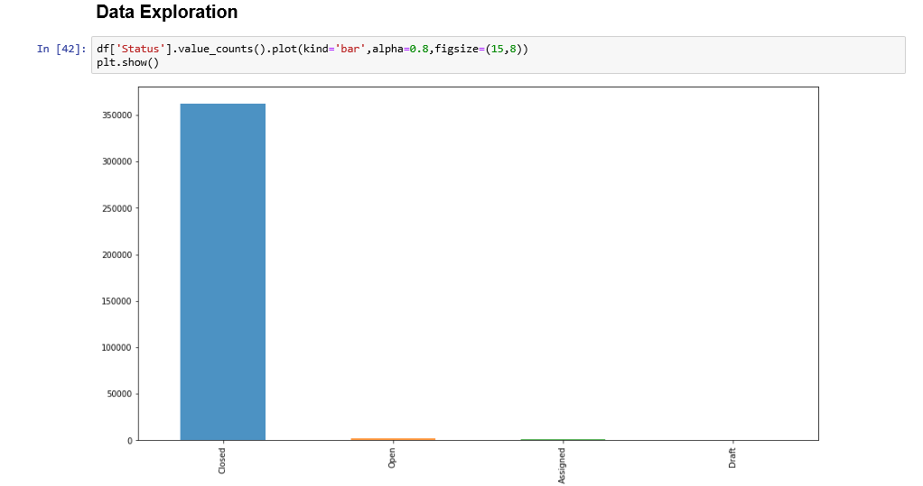

Slide 18
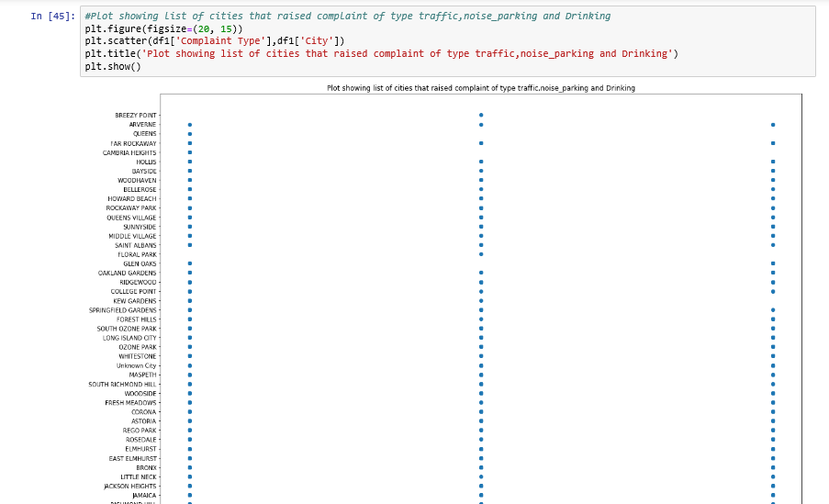

Slide 19
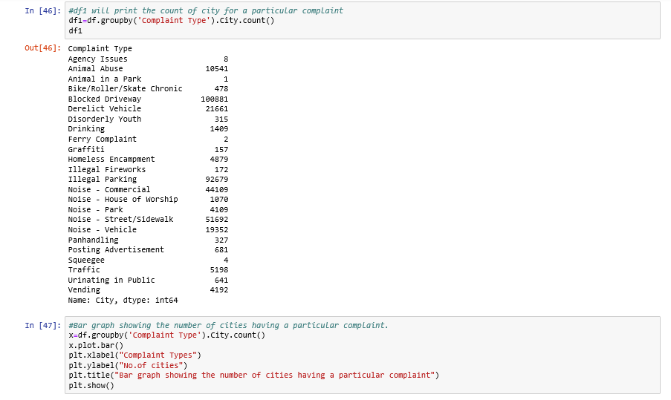

Slide 20
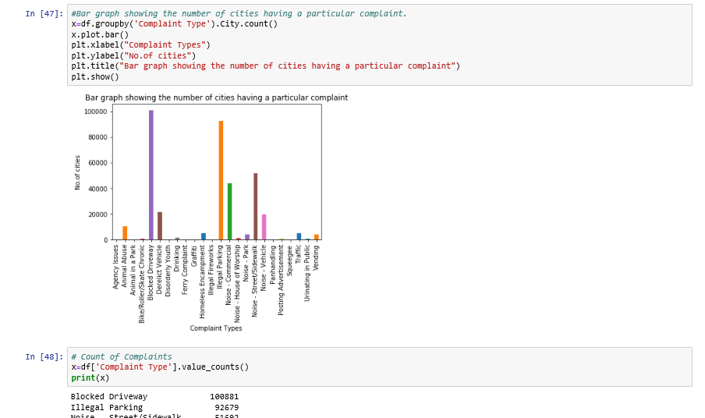

Slide 21
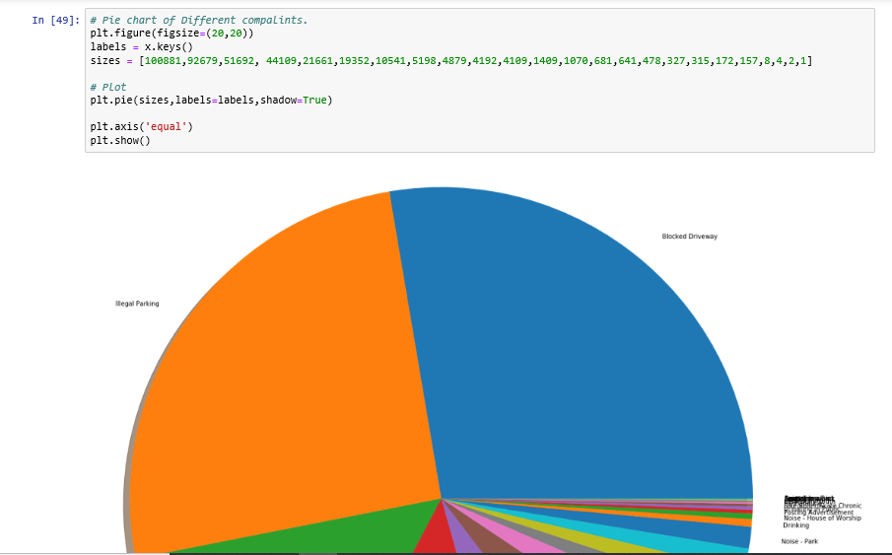

Slide 22
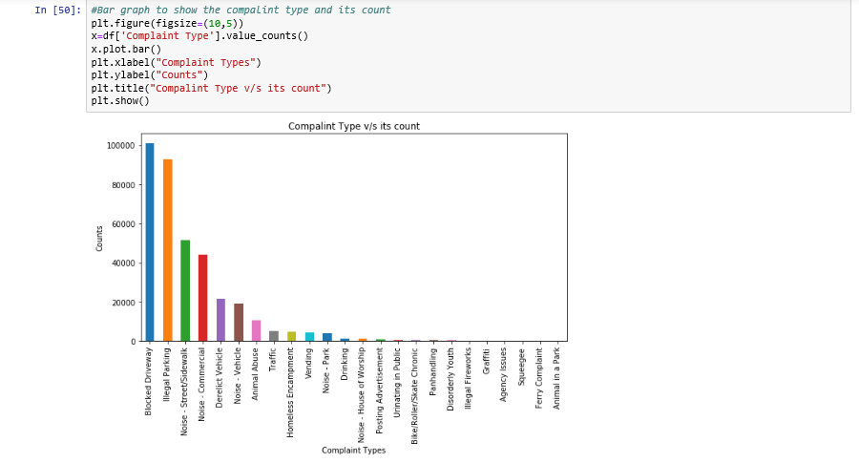

Slide 23
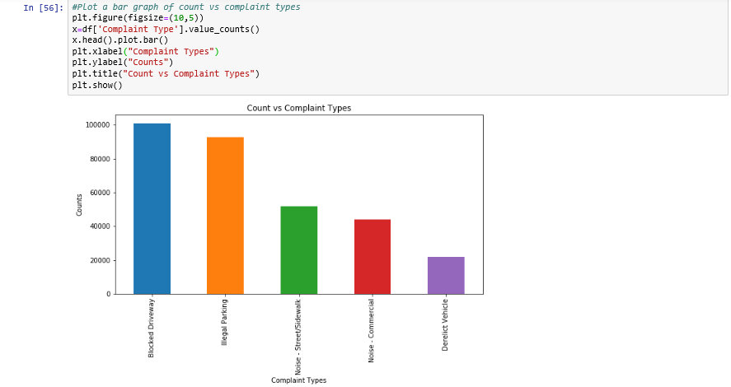

Slide 24

Large Picture Slide
Over the next 5 years, data scientists will develop the ability to utilize all sorts of data in real-time. This will fuel the need for making more intricate predictions and computations at scale which will spark the emergence of new data science paradigms due to the needs of future applications. More and more data will be used to drive key business decisions, and will enable innovations like “Deep Learning” that allow for accurate predictions and decision making. Further, modern applications have brought to fore new statistical paradigms such as recommendation systems that are key enablers for many of the modern businesses being media portals, e-commerce portals, or social interaction platforms.
Future Of Data Science

Slide 25



THANK YOU
Shivam Patel
9451776213
shivampatel251097@gmail.com

